Slide 1
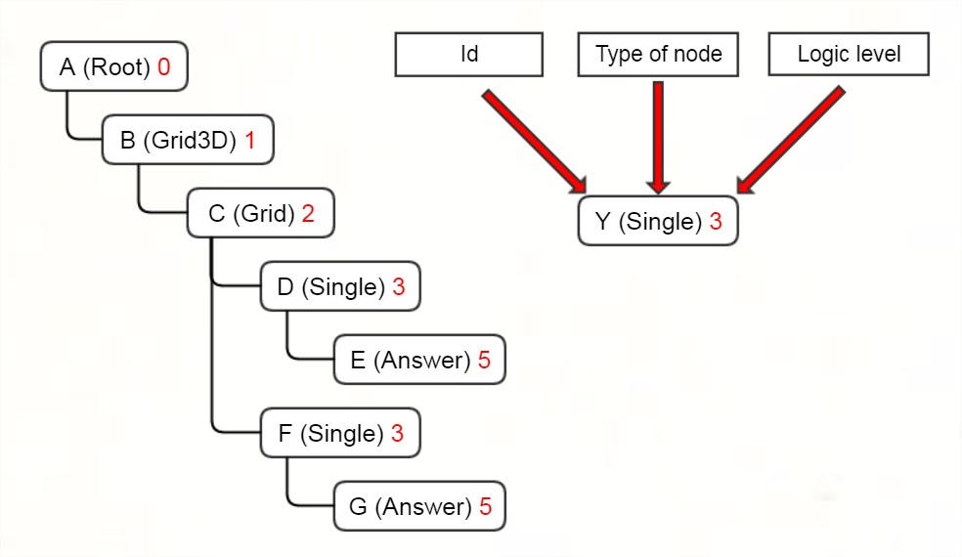
Abstract trees

Slide 2
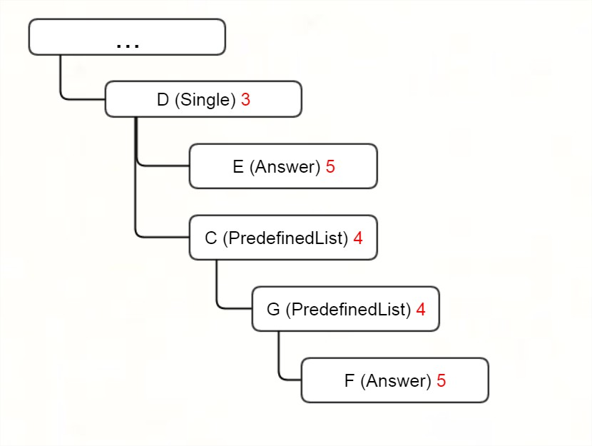

Slide 3

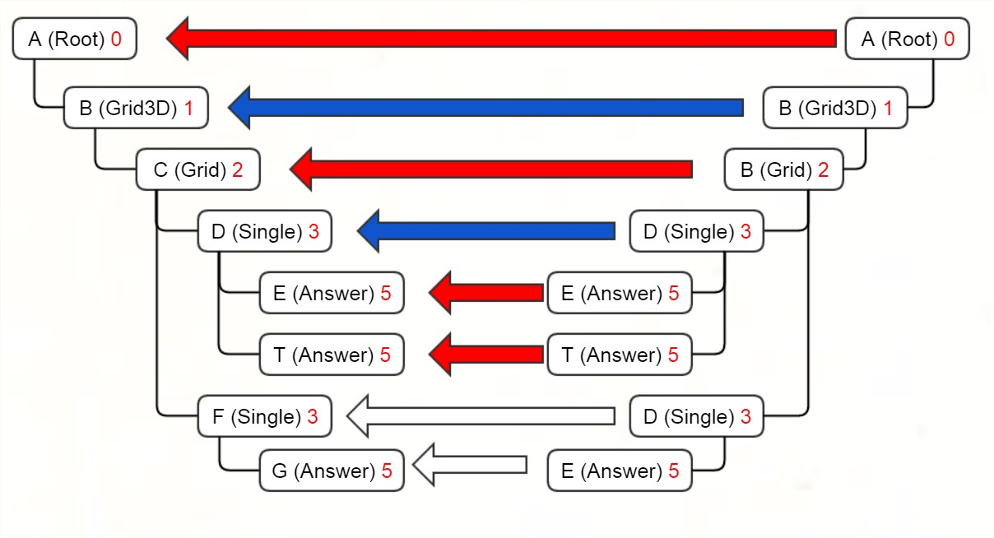
Strong
Relative
Absent

Slide 4
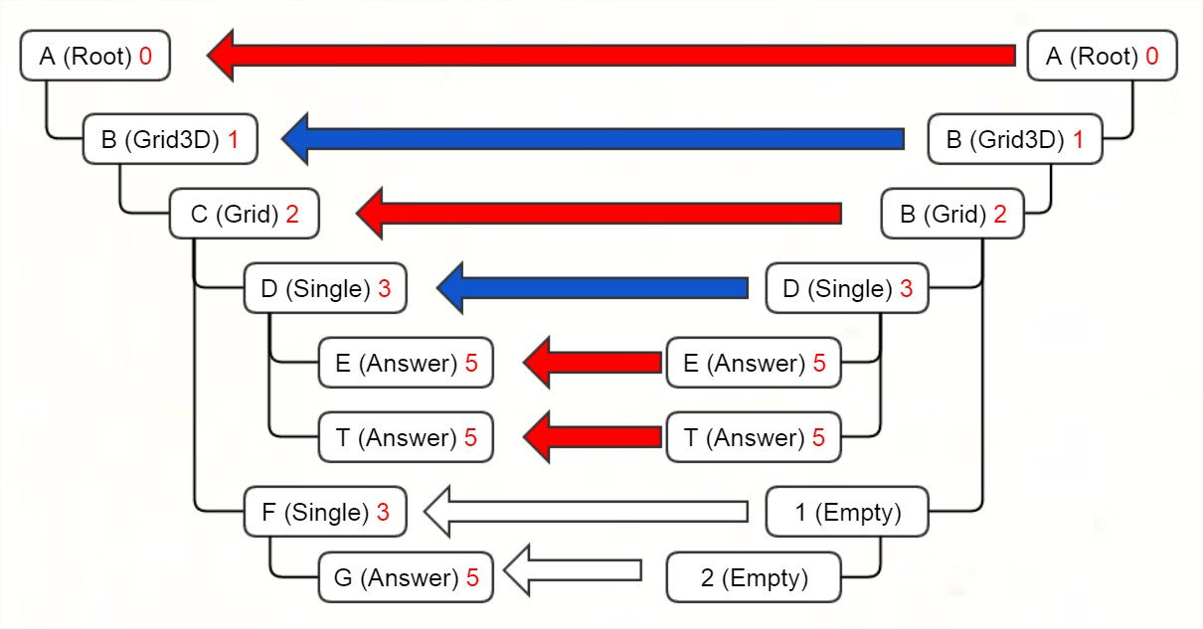
Strong
Relative
Absent

Slide 5
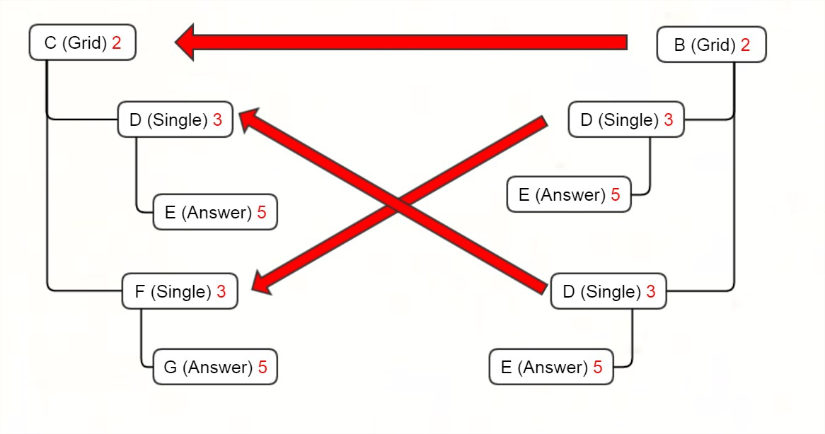
Strong
Relative
Absent

Slide 6
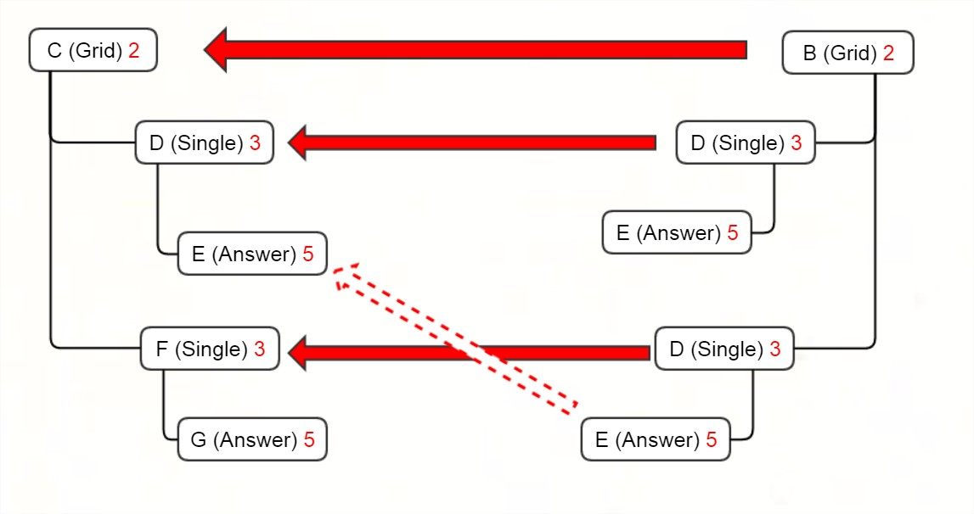
Strong
Relative
Absent

Slide 7
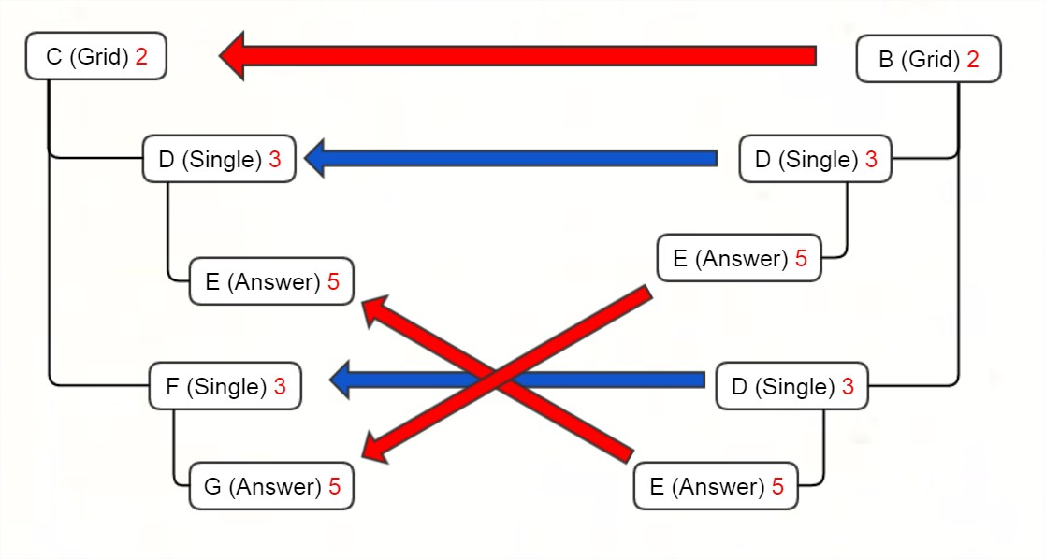
Strong
Relative
Absent

Slide 8
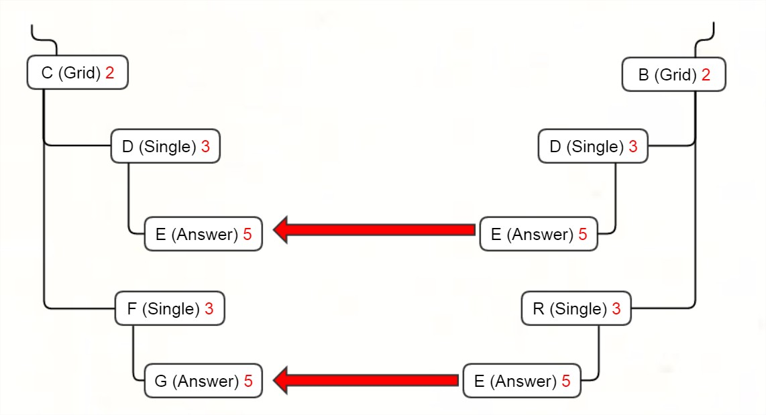
Strong
Relative
Absent

Slide 9
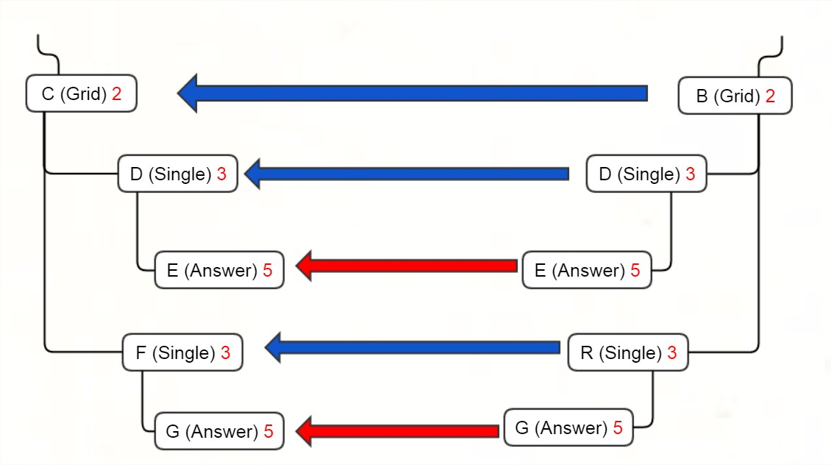
Strong
Relative
Absent

Slide 10
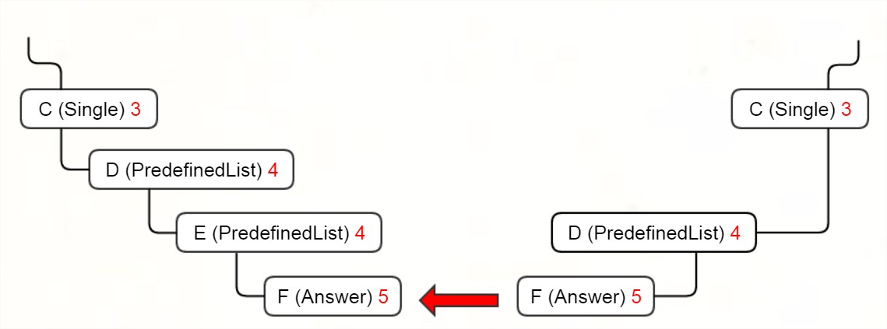
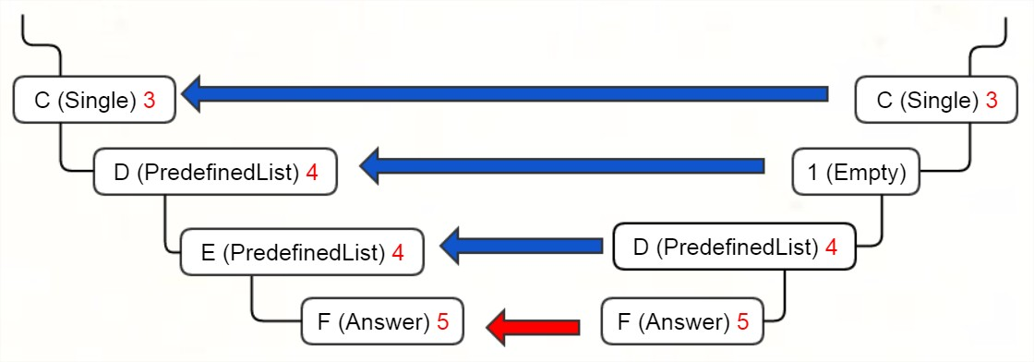
Strong
Relative
Absent

Slide 11
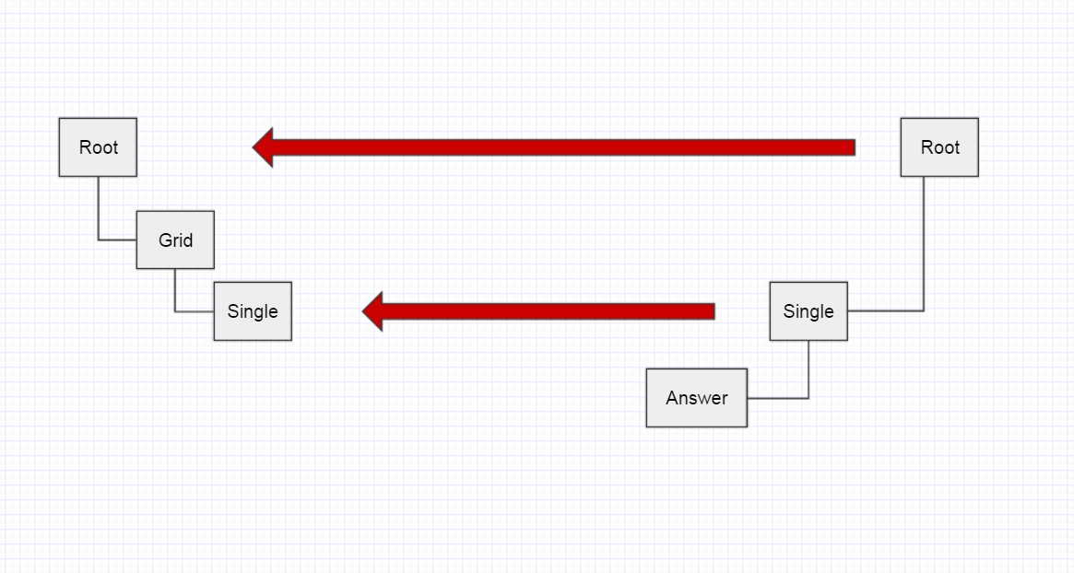
Strong
Relative
Absent

Slide 12
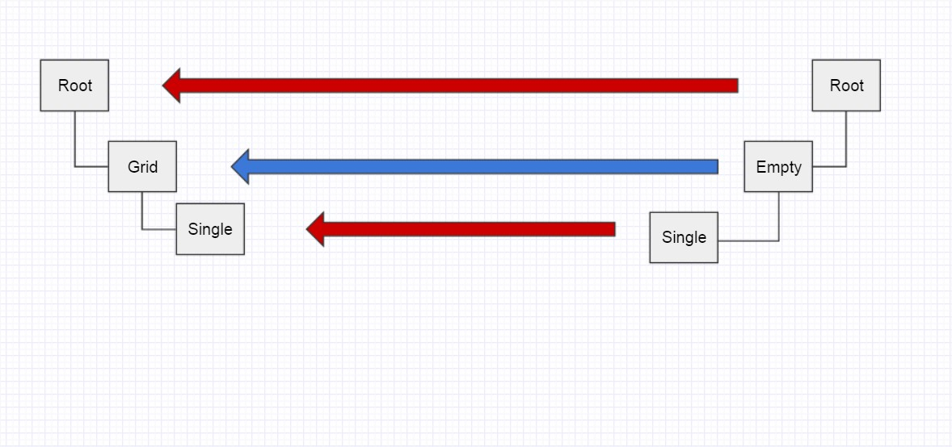
Strong
Relative
Absent

Slide 13
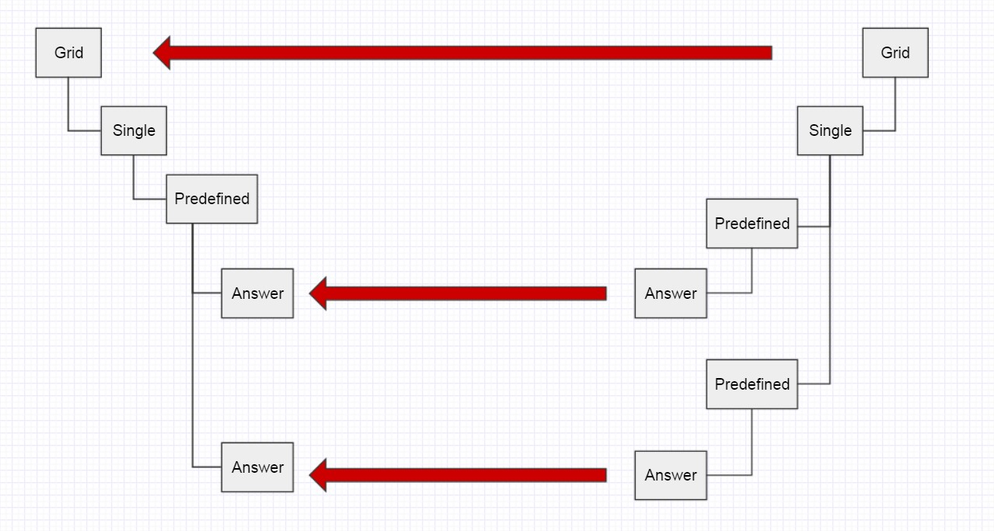
Strong
Relative
Absent

Slide 14
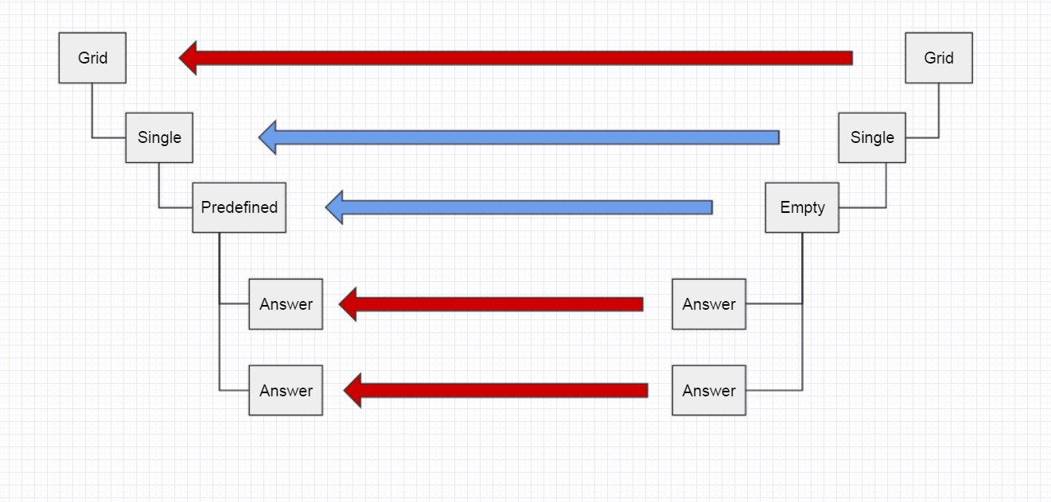
Strong
Relative
Absent

Slide 15
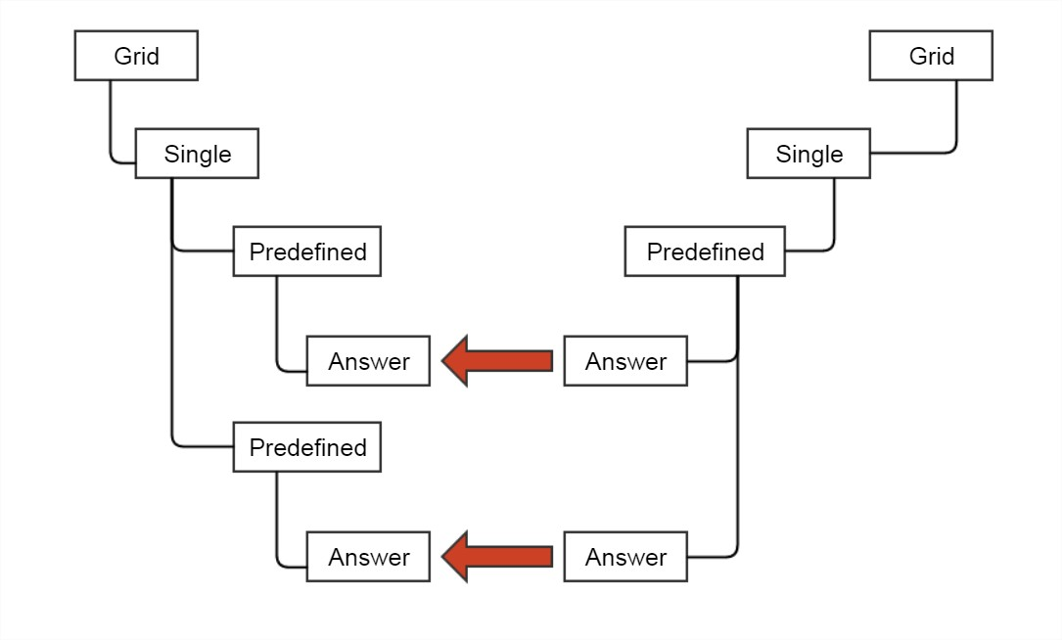
Strong
Relative
Absent

Slide 16
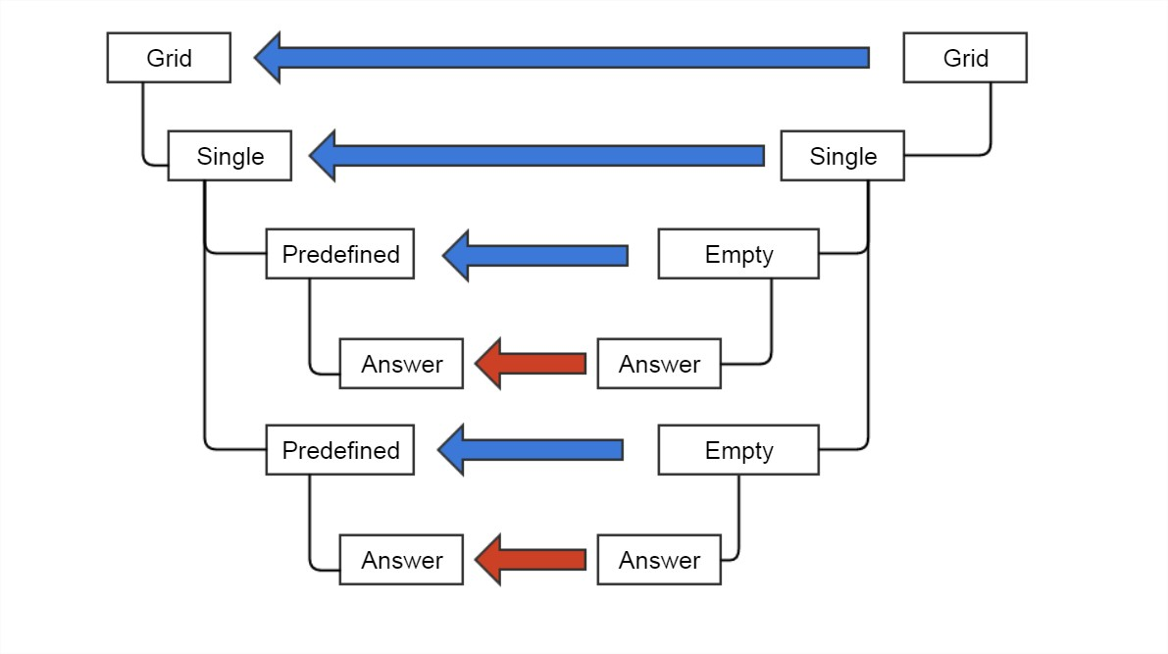
Strong
Relative
Absent

Slide 17
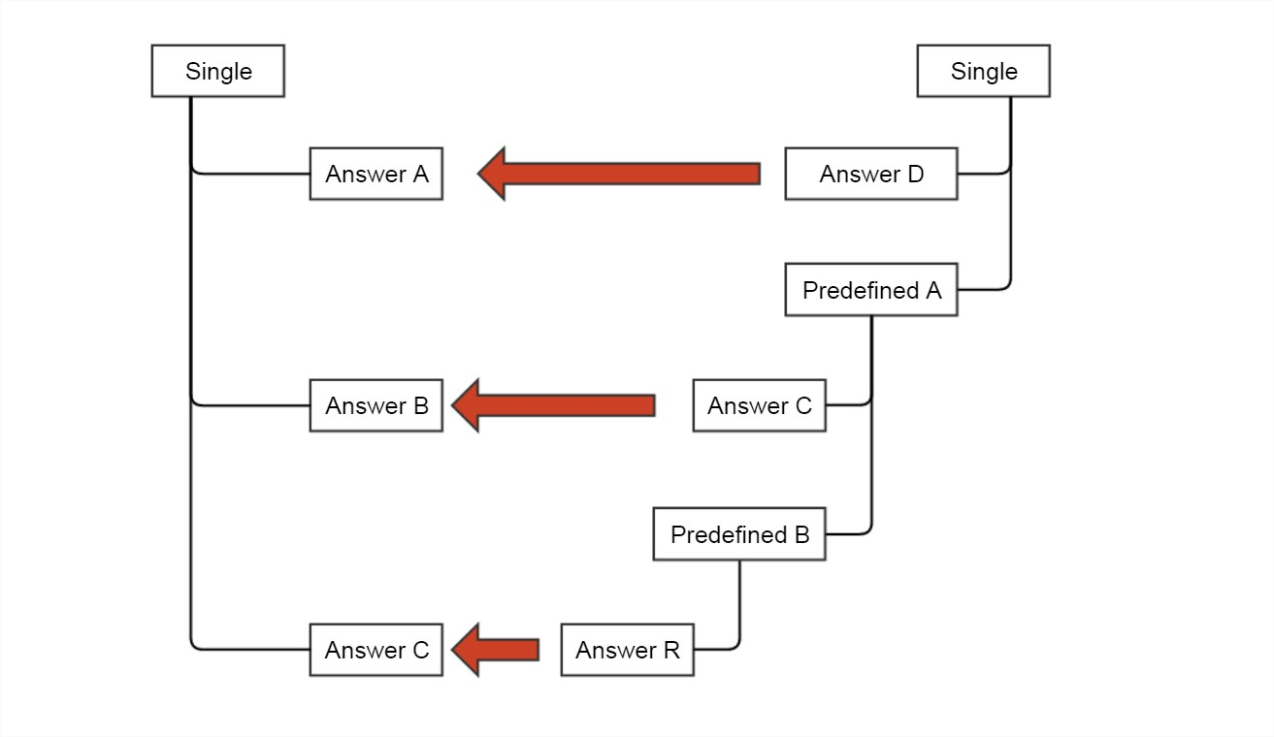
Strong
Relative
Absent

Slide 18
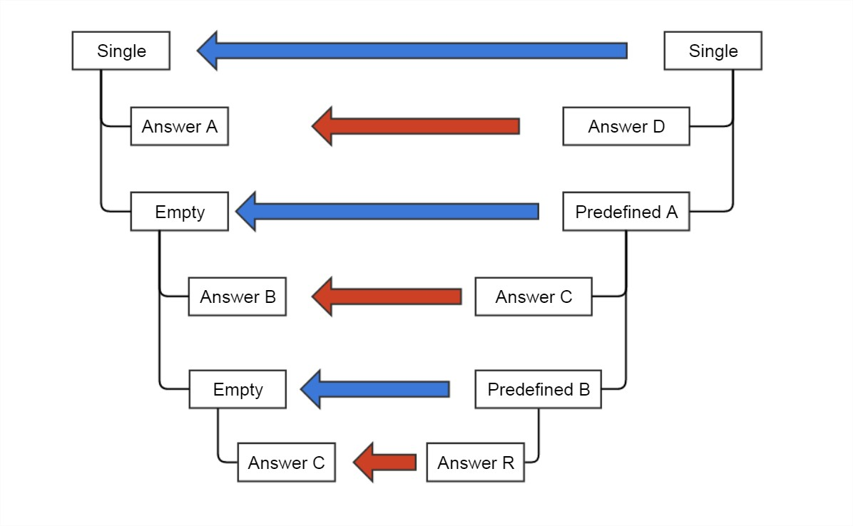
Strong
Relative
Absent

Slide 19
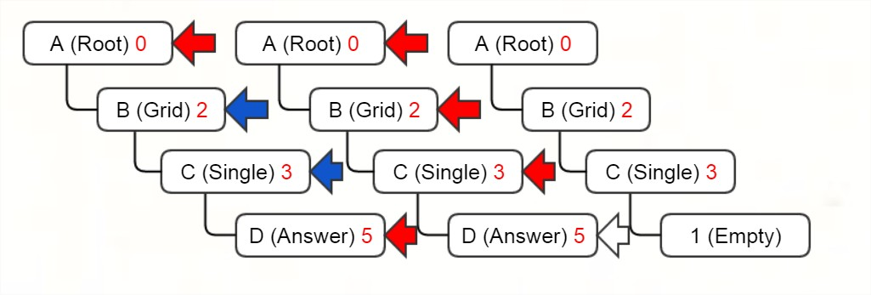
Strong
Relative
Absent

